Slide 1
Employee Satisfaction
Employees’ satisfaction level with internal services
Notes:
Our project comprises to evaluate how satisfied employees are with company internal services of different departments.
Therefore, we used a dataframe that contains the results of an annual employee survey with the aim to:

Slide 2
Project goal
Figure out how to improve
internal company services

Slide 3
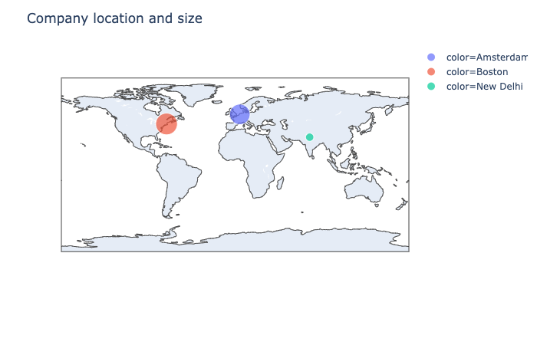
About the company
Amsterdam
Boston
New Delhi
consulting company
413 employees
3 locations worldwide
Notes:
Therefore, we used a dataframe that contains the results of an annual employee survey with the aim to:

Slide 4

Our Data is based on an employee survey
Employees’ profile
Contact times with departments
Reasons for contact
Rating of contact
Rating of service quality
Departments
Accounting
HR
Office Management
Security
Data & Records
Notes:
Therefore, we used a dataframe that contains the results of an annual employee survey with the aim to:

Slide 5
Key findings

Slide 6
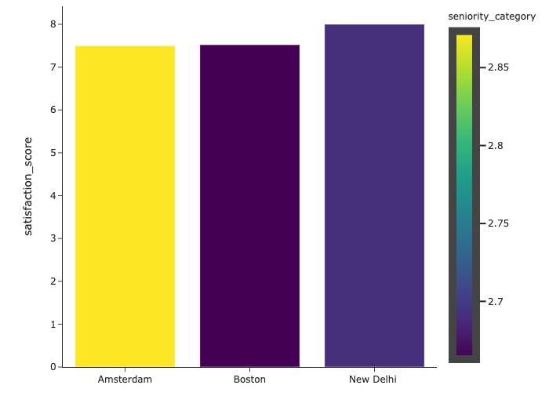
Happy New Delhi
Satisfaction by Location
8
Seniority
7.5
7.52
Employee satisfaction in New Delhi is the highest.
Over 21 years
11-20 years
Satisfaction Score
The 3-5 years seniority level,
Has the lowest the satisfaction rate
6-10 years
3-5 years
Up to 2 years
Amsterdam
Boston
New Delhi

Slide 7
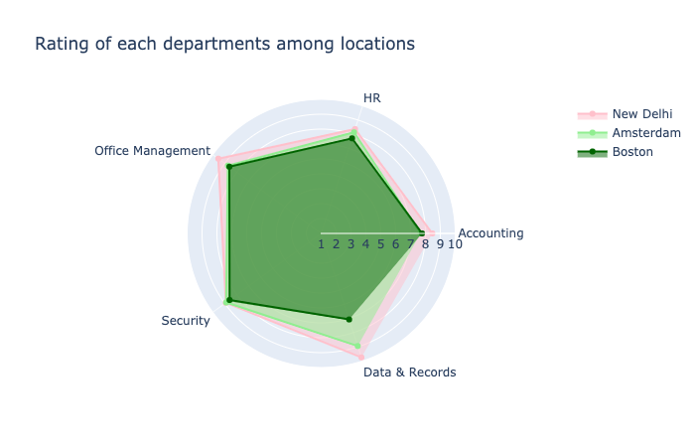
Happy New Delhi
Rating of Department Contact
Ratings for New Delhi
are consistently higher than for other locations!

Slide 8
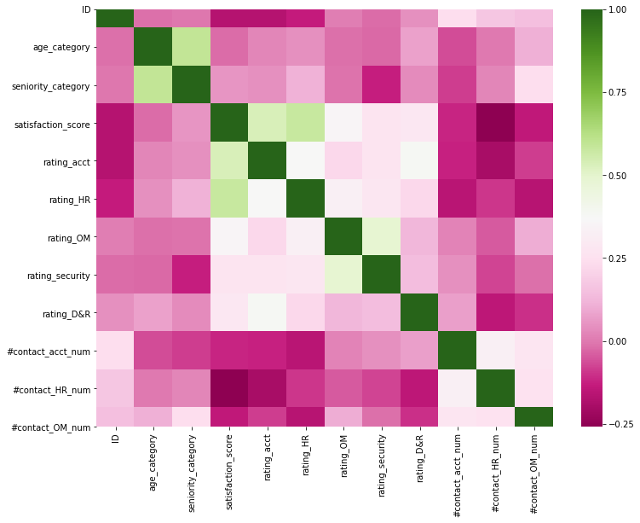
What affects the Satisfaction Score?
The Satisfaction Score
is positively related with
the Accounting rating
& HR rating.
Accounting rating
HR rating
Satisfaction
score
Relation Index

Slide 9
Pressure points
Methodology
Sub-questions to rate different service quality:
Service related to payroll
Professionalism
Courtesy...etc
Check relationship of rating in each sub-question with:
Satisfaction Score (Overall)
Department Rating
Accounting
Professionalism
Reimbursement of expenditure
Service for payrolls
HR
Professionalism
Off-boarding process
Relocation and reassignment process

Slide 10
Recommendations
Gain knowledge from New Delhi office
Improve Accounting & HR services focusing on the 5 main fields
Conduct employee survey once per year

Slide 11



Thanks!
. . . are you satisfied ?

